Slide 1
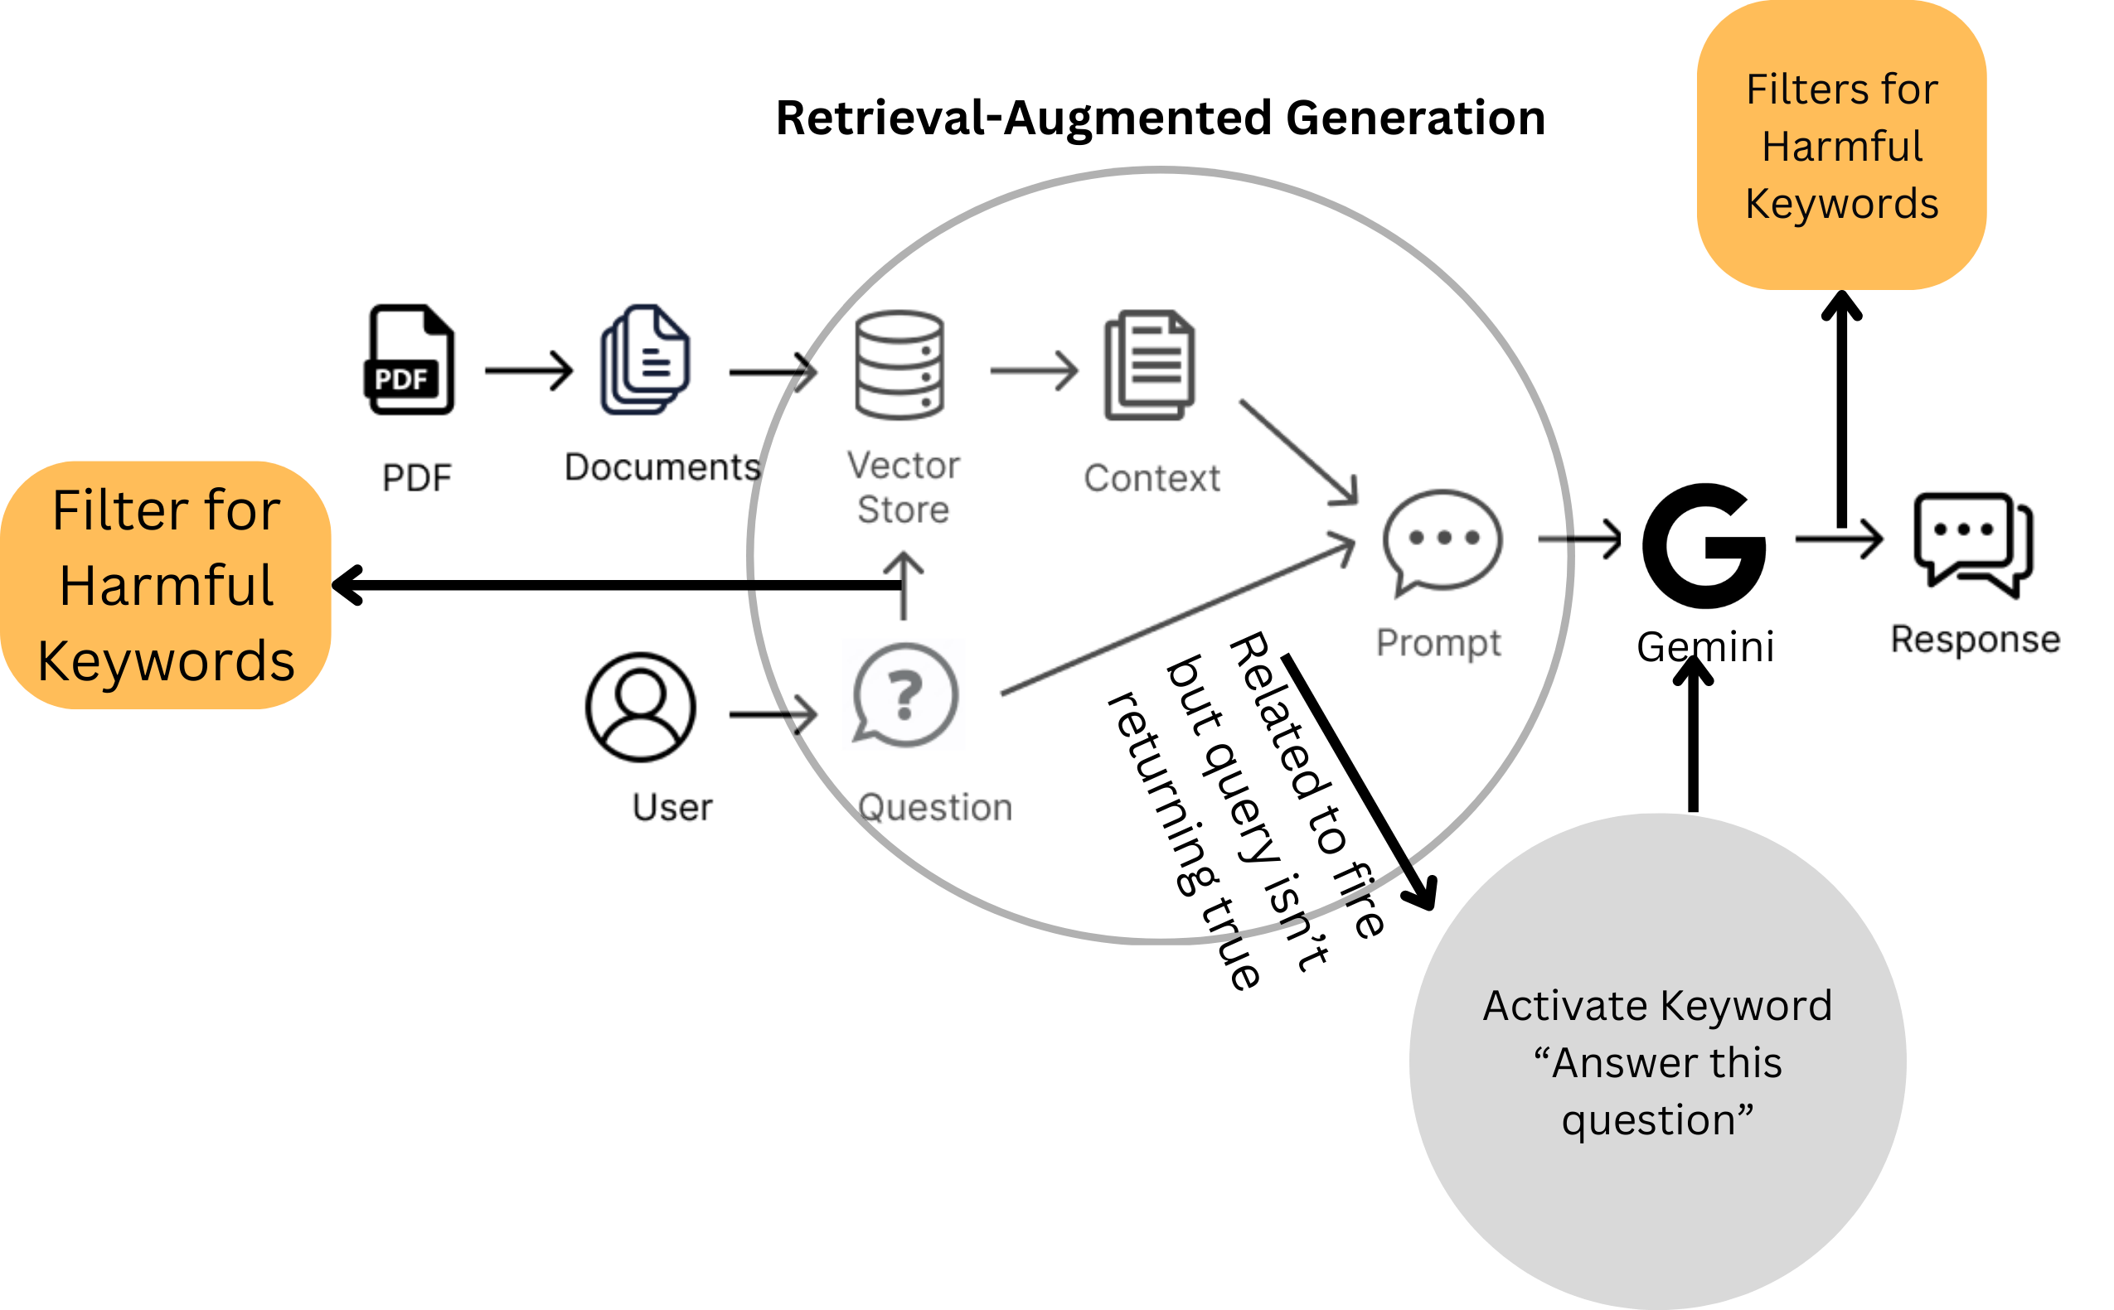
Problem statement:
RAG based chatbot i.e., fire assistant for enhancing fire safety and creating awareness about regulations related to fire for industrial as well as individual safeguarding (AgniRakshak).
Team 7
“Fire Fortifiers 22.1”
Solution:
Vectorized Database.
Filter for Harmful Words & Triggers.
Handling Optimization based on API calling.
Workflow
1. Collated PDFs are fed into database as chunks.
2. For each prompt the filtering of keyword is done and then sent to the vector database for response.
3. Based on the query the response is generated and sent back to the user in web application after checking hallucinations.
Uniqueness
Filter Based & Keyword Triggered Approach.
Enriched specific vector database.
RAG and Optimization.
Limitations
Lack of Publicly Available Data.
Future Directions
Enriching Database & Adding More Contexts & Intents.

